Slide 1


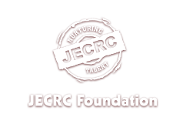

Slide 2
BC0 008B
Operating Systems
Unit-I

Slide 3
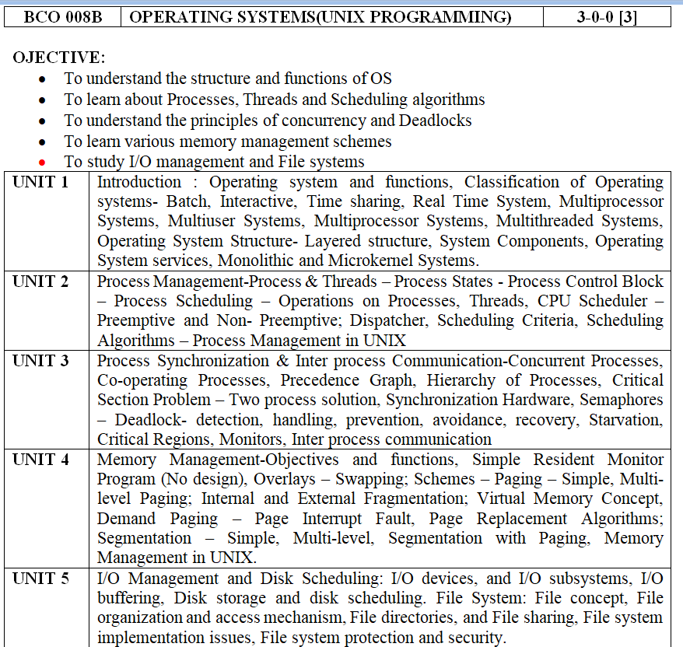

Slide 4
Text Books:
1. Operating Systems Concepts – Silberschatz, Galvin, Wiley Publications (2008)
2. Modern Operating Systems - Andrew S. Tanenbaum, Pearson Education Asia / PHI(2005)
Reference Books:
Operating Systems – William Stallings, Pearson Education Asia (2002)
UNIX System Programming Using C++, by Terrence Chan: Prentice Hall India, 1999.
Advanced Programming in UNIX Environment, by W. Richard Stevens: 2nd Ed, Pearson Education, 2005

Slide 5
Course Outcome (CO):
At the ends of this course studentswill have:
CO1: Classify Unix Kernel mode with user mode & contrast between Kernel structures.
CO2: Identify and estimate process management & thread management strategies along with their different operations
CO3: Implement deadlock and different system calls for various file handling operations.
CO4: Determine Paging and Caching techniques related to Virtual Memory.

Slide 6
Mapping of COs with Pos
MAPPING COURSE OUTCOMES LEADING TO THE ACHIEVEMENT OF
PROGRAM OUTCOMES AND PROGRAM SPECIFIC OUTCOMES:
Course Outcome | Program Outcome |  |  |  |  |  |  |  |  |  |  |  | Program Specifice Outcome
 | PO1 | PO2 | PO3 | PO4 | PO5 | PO6 | PO7 | PO8 | PO9 | PO10 | PO11 | PO12 | PSO1 | PSO2 | PSO3
CO1 | H |  |  | M |  |  |  | L |  |  | L |  | H |  | L
CO2 |  | M | L |  |  |  |  |  | M |  |  |  |  | M
CO3 |  |  | M |  | M |  |  |  |  |  |  |  |  | M | M
CO4 | M |  | L |  |  |  |  |  |  |  |  | L
H = Highly Related; M = Medium L = Low

Slide 7
UNIT 1 - Operating System
Operating system and functions, Classification of Operating systems- Batch, Interactive, Time sharing, Real Time System, Multiprocessor,Systems, Multiuser Systems, Multiprocessor Systems, Multithreaded Systems, Operating System Structure- Layered structure, System Components, Operating System services, Monolithic and Microkernel Systems.

Slide 8
Introduction
1.1 What is an operating system
1.2 History of operating systems
1.3 Operating system and functions
1.4 The operating system Types
1.5 Computer hardware review
1.6 Operating system concepts
1.7 System calls
1.8 Operating system structure - Layered structure
1.9 OS System Components and structures (Windows,linux,MSDOS,UNIX)
2.0 Operating,System services
2.1 Monolithic and Microkernel Systems.

Slide 9
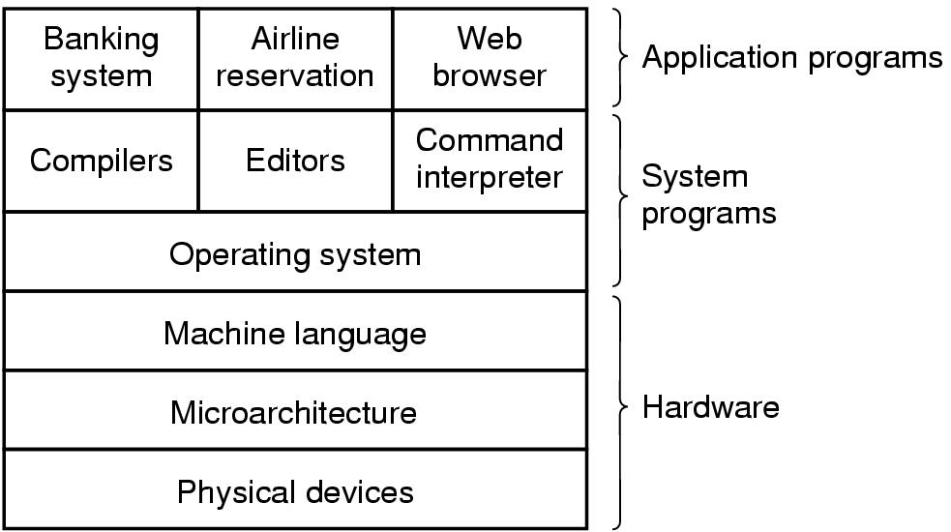
1.1 Introduction
A computer system consists of
hardware
system programs
application programs

Slide 10
1.2 What is an Operating System
It is an extended machine
Hides the messy details which must be performed
Presents user with a virtual machine, easier to use
It is a resource manager
Each program gets time with the resource
Each program gets space on the resource

Slide 11
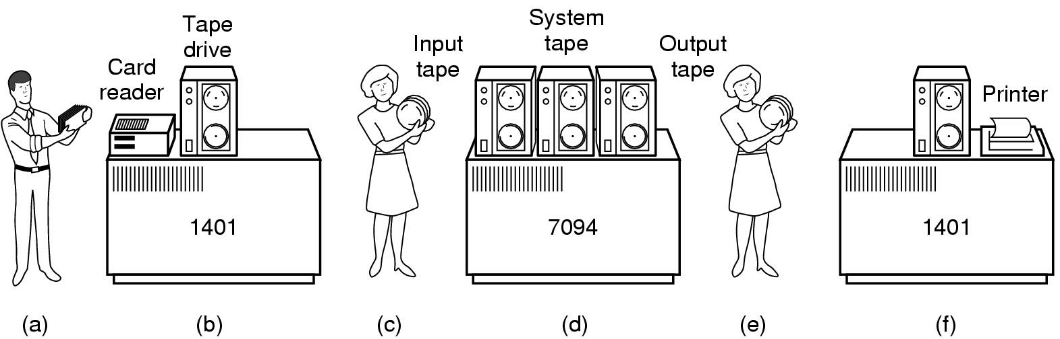
1.2 History of Operating Systems (1)
Early batch system
bring cards to 1401
read cards to tape
put tape on 7094 which does computing
put tape on 1401 which prints output

Slide 12
History of Operating Systems (2)
First generation 1945 - 1955
vacuum tubes, plug boards
Second generation 1955 - 1965
transistors, batch systems
Third generation 1965 – 1980
ICs and multiprogramming
Fourth generation 1980 – present
personal computers

Slide 13
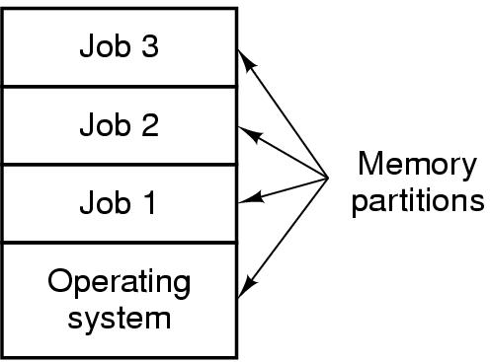
History of Operating Systems (4)
Multiprogramming system
three jobs in memory – 3rd generation

Slide 14
Computer System Components
1. Hardware – provides basic computing resources (CPU, memory, I/O devices).
2. Operating system – controls and coordinates the use of the hardware among the various application programs for the various users.
3. Applications programs – define the ways in which the system resources are used to solve the computing problems of the users (compilers, database systems, video games, business programs).
4. Users (people, machines, other computers).

Slide 15
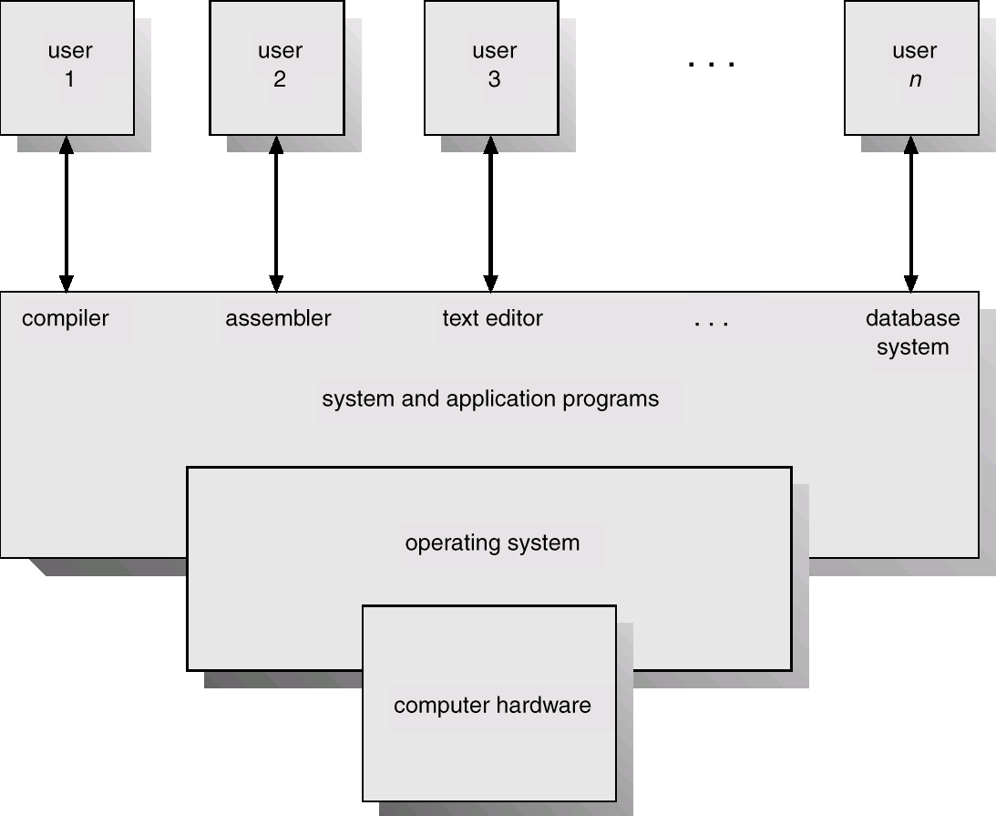
Abstract View of System Components

Slide 16
Operating System Definitions
Resource allocator – manages and allocates resources.
Control program – controls the execution of user programs and operations of I/O devices .
Kernel – the one program running at all times (all else being application programs).

Slide 17
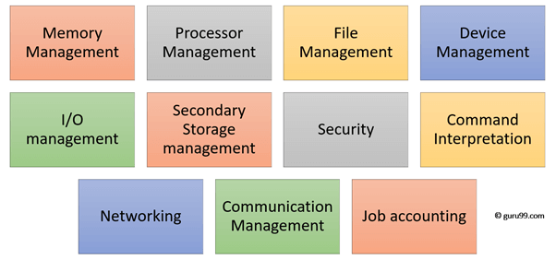
Functions of an operating System
Memory Management
Processor Management
Device Management
File Management
Security
Control over system performance
Job accounting
Error detecting aids
Coordination between other software and users

Slide 18
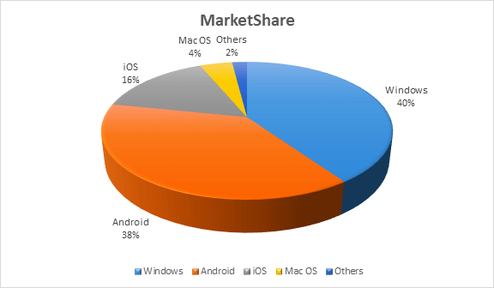

Slide 19
The Operating System Types
Mainframe operating systems
Multiprocessor operating systems
Distributed Systems
Personal computer operating systems
Real-time operating systems
Embedded operating systems

Slide 20
1.4 Types of OS :Mainframe Systems
Reduce setup time by batching similar jobs
Automatic job sequencing – automatically transfers control from one job to another. First rudimentary operating system.
Resident monitor
initial control in monitor
control transfers to job
when job completes control transfers pack to monitor

Slide 21
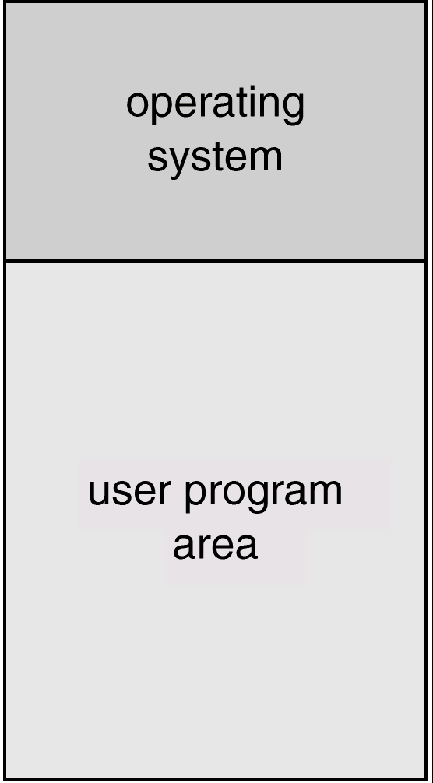
1.4 Types of OS : Simple Batch System
The problems with Batch Systems are as follows −
Lack of interaction between the user and the job.
CPU is often idle, because the speed of the mechanical I/O devices is slower than the CPU.
Difficult to provide the desired priority.

Slide 22
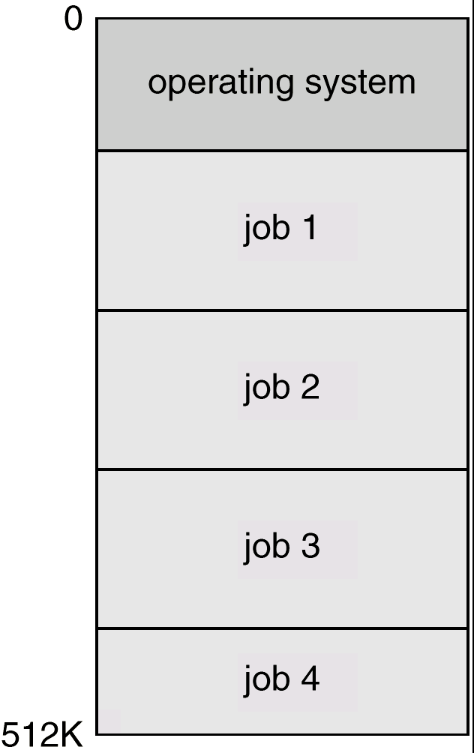
1.4 Types of OS : Multiprogrammed Batch Systems
Several jobs are kept in main memory at the same time, and the
CPU is multiplexed among them.

Slide 23
OS Features Needed for Multiprogramming
I/O routine supplied by the system.
Memory management – the system must allocate the memory to several jobs.
CPU scheduling – the system must choose among several jobs ready to run.
Allocation of devices.

Slide 24
1.4 Types of OS : Time-Sharing Systems–Interactive Computing
The CPU is multiplexed among several jobs that are kept in memory and on disk (the CPU is allocated to a job only if the job is in memory).
A job swapped in and out of memory to the disk.
On-line communication between the user and the system is provided; when the operating system finishes the execution of one command, it seeks the next “control statement” from the user’s keyboard.
On-line system must be available for users to access data and code.
Advantages of Timesharing operating systems
Provides the advantage of quick response.
Avoids duplication of software.
Reduces CPU idle time.
Disadvantages of Time-sharing operating systems
Problem of reliability.
Question of security and integrity of user programs and data.
Problem of data communication.

Slide 25
1.4 Types of OS : Desktop Systems
Personal computers – computer system dedicated to a single user.
I/O devices – keyboards, mice, display screens, small printers.
User convenience and responsiveness.
Can adopt technology developed for larger operating system’ often individuals have sole use of computer and do not need advanced CPU utilization of protection features.
May run several different types of operating systems (Windows, MacOS, UNIX, Linux)

Slide 26
1.4 Types of OS : Network operating System
The primary purpose of the network operating system is to allow shared file and printer access among multiple computers in a network, typically a local area network (LAN), a private network or to other networks
The advantages of network operating systems are −
Centralized servers are highly stable.
Security is server managed.
Upgrades to new technologies and hardware can be easily integrated into the system.
Remote access to servers is possible from different locations and types of systems.
The disadvantages of network operating systems are as follows −
High cost of buying and running a server.
Dependency on a central location for most operations.
Regular maintenance and updates are required

Slide 27
1.4 Types of OS : Parallel Systems
Multiprocessor systems with more than on CPU in close communication.
Tightly coupled system – processors share memory and a clock; communication usually takes place through the shared memory.
Advantages of parallel system:
Increased throughput
Economical
Increased reliability
graceful degradation
fail-soft systems

Slide 28
Parallel Systems (Cont.)
Symmetric multiprocessing (SMP)
Each processor runs and identical copy of the operating system.
Many processes can run at once without performance deterioration.
Most modern operating systems support SMP
Asymmetric multiprocessing
Each processor is assigned a specific task; master processor schedules and allocated work to slave processors.
More common in extremely large systems

Slide 29
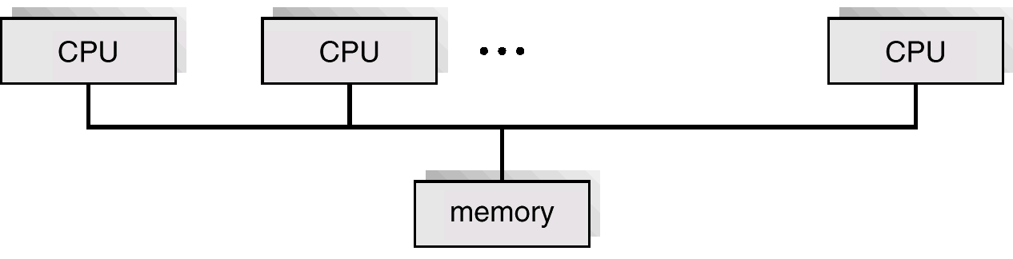
Symmetric Multiprocessing Architecture

Slide 30
1.4 Types of OS : Distributed Systems
Distribute the computation among several physical processors.
Loosely coupled system – each processor has its own local memory; processors communicate with one another through various communications lines, such as high-speed buses or telephone lines.
Advantages of distributed systems.
Resources Sharing
Computation speed up – load sharing
Reliability
Communications
Better service to the customers.
Reduction of the load on the host computer.
Reduction of delays in data processing.

Slide 31
Distributed Systems (cont)
Requires networking infrastructure.
Local area networks (LAN) or Wide area networks (WAN)
May be either client-server or peer-to-peer systems.

Slide 32
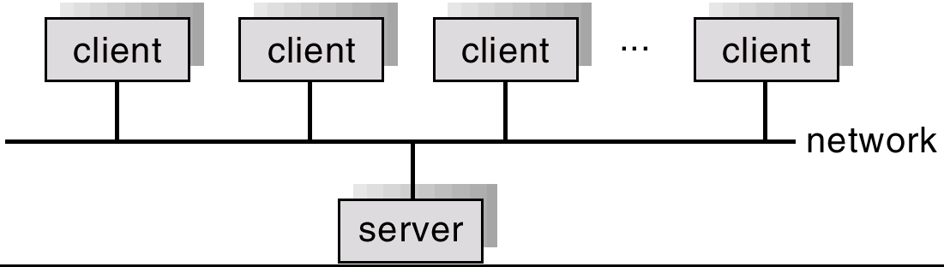
General Structure of Client-Server

Slide 33
1.4 Types of OS : Real-Time Systems
Often used as a control device in a dedicated application such as controlling scientific experiments, medical imaging systems, industrial control systems, and some display systems.
Well-defined fixed-time constraints.
Real-Time systems may be either hard or soft real-time.

Slide 34
Real-Time Systems (Cont.)
Hard real-time:
Secondary storage limited or absent, data stored in short term memory, or read-only memory (ROM)
Conflicts with time-sharing systems, not supported by general-purpose operating systems.
Soft real-time
Limited utility in industrial control of robotics
Useful in applications (multimedia, virtual reality) requiring advanced operating-system features.

Slide 35
1.4 Types of OS : Handheld Systems
Personal Digital Assistants (PDAs)
Cellular telephones
Issues:
Limited memory
Slow processors
Small display screens.

Slide 36
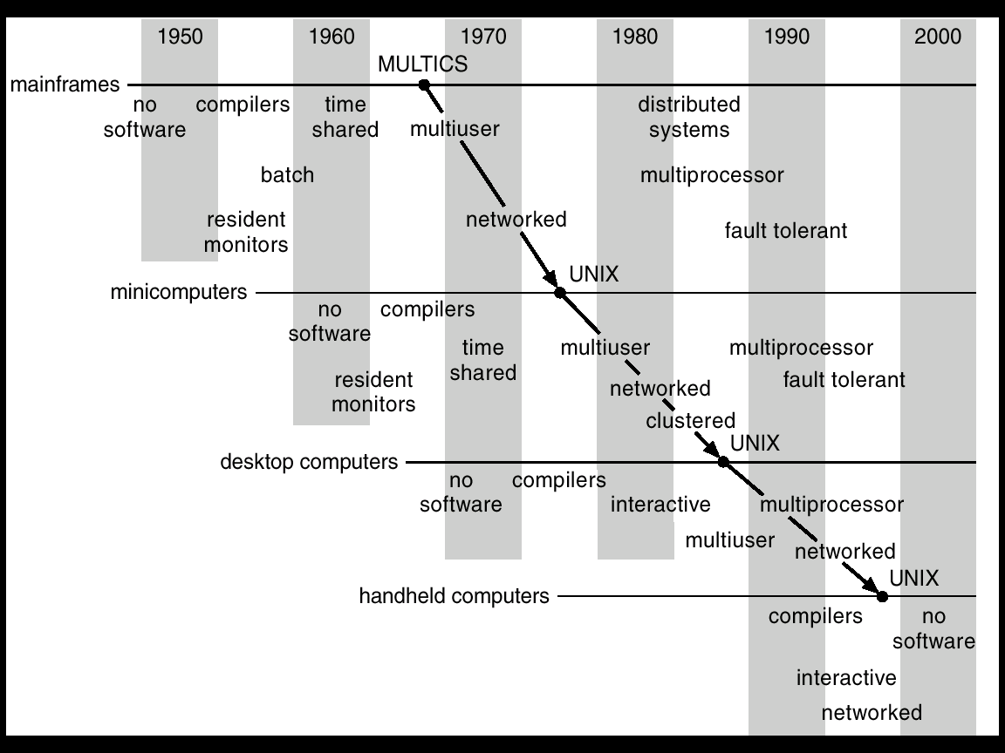
Migration of Operating-System Concepts and Features

Slide 37
Examples of OS
Examples of Batch based Operating System: Payroll System, Bank Statements etc.
Examples of Time-Sharing OSs are: Multics, Unix etc.
Examples of Distributed Operating System are- LOCUS , IRIX. ,DYNIX.,OSF/1.
Examples of Network Operating System are: Microsoft Windows Server 2003, Microsoft Windows Server 2008, UNIX, Linux, Mac OS X, Novell NetWare, and BSD etc.
Example of Real time OS : FreeRTOS Owned by Amazon ,NoIntegrityGreen Hills Keil RTX, LynxOS

Slide 38
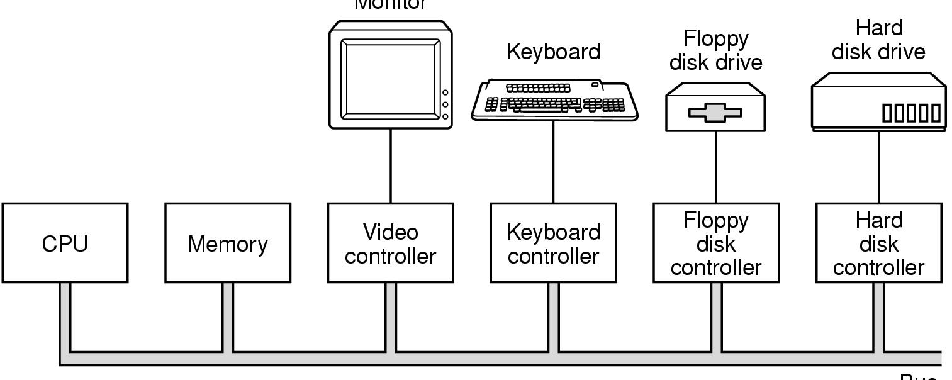
1.5 Computer Hardware Review (1)
Monitor
Bus
Components of a simple personal computer

Slide 39
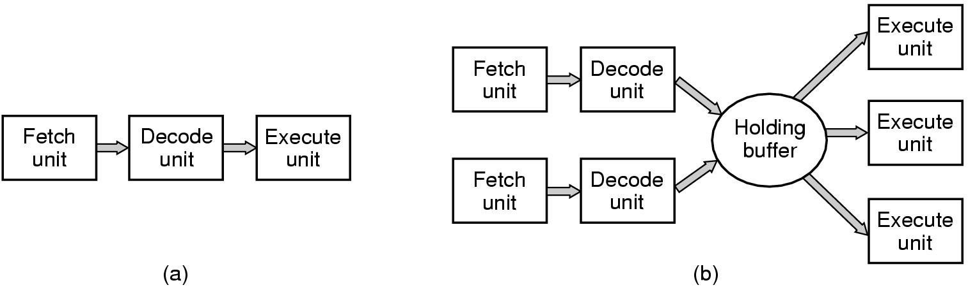
Computer Hardware Review (2)
(a) A three-stage pipeline
(b) A superscalar CPU

Slide 40
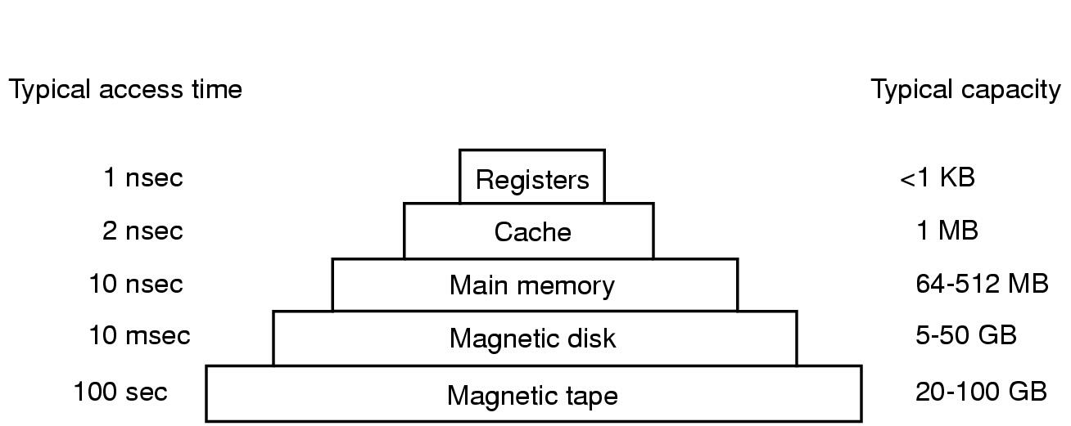
Computer Hardware Review (3)
Typical memory hierarchy
numbers shown are rough approximations

Slide 41
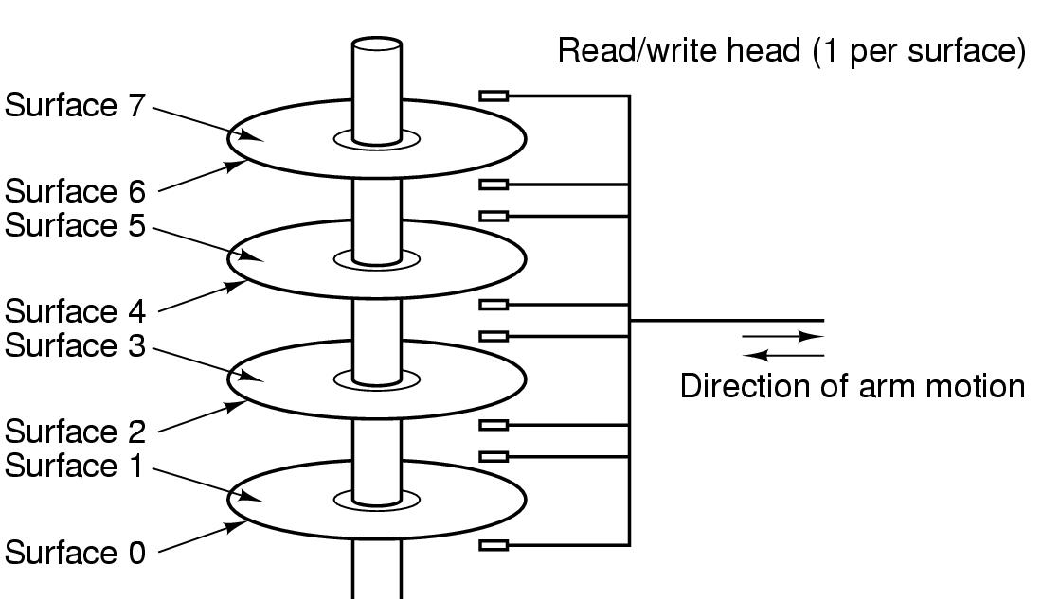
Computer Hardware Review (4)
Structure of a disk drive

Slide 42
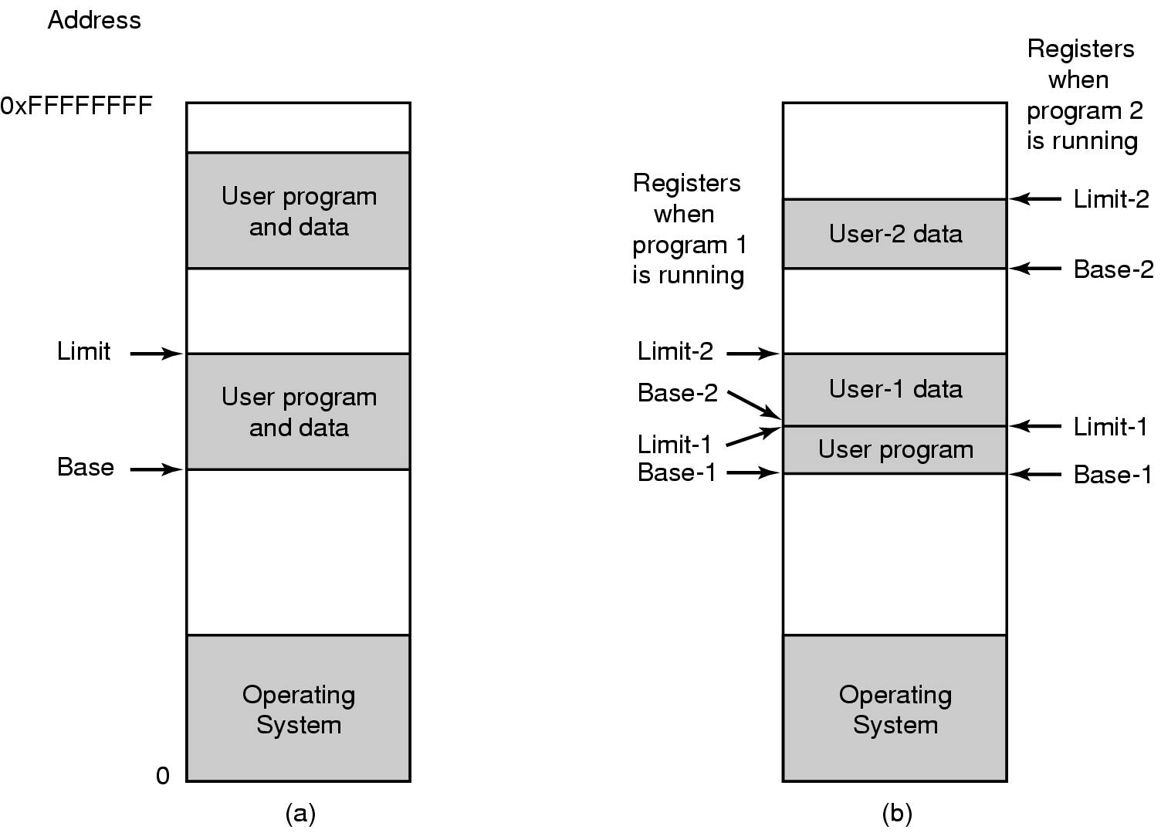
Computer Hardware Review (5)
One base-limit pair and two base-limit pairs

Slide 43
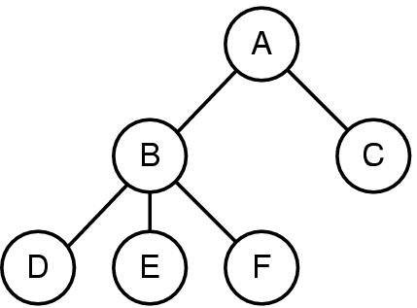
1.6 Operating System Concepts
A process tree
A created two child processes, B and C
B created three child processes, D, E, and F

Slide 44
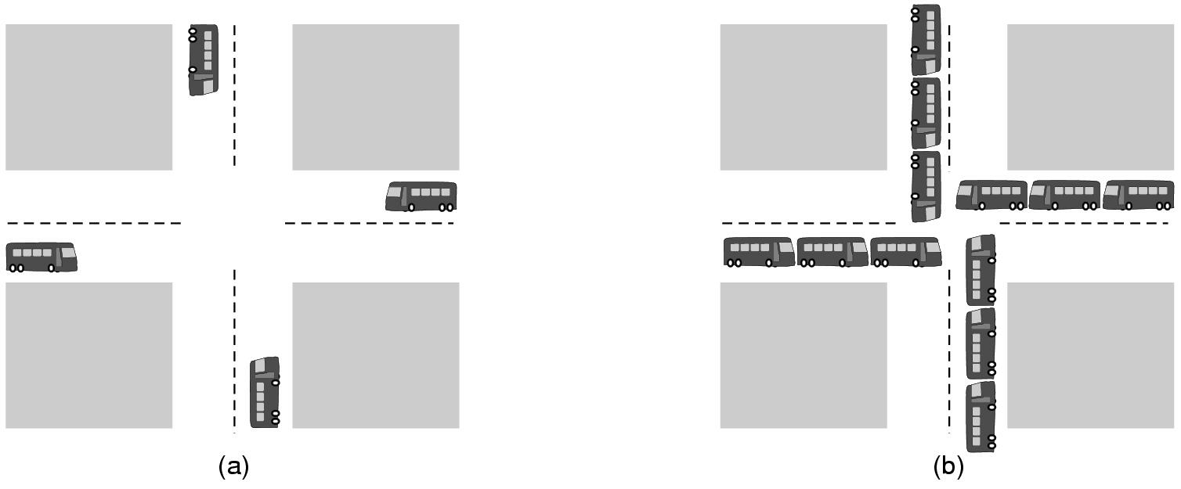
Operating System Concepts (2)
(a) A potential deadlock. (b) an actual deadlock.

Slide 45
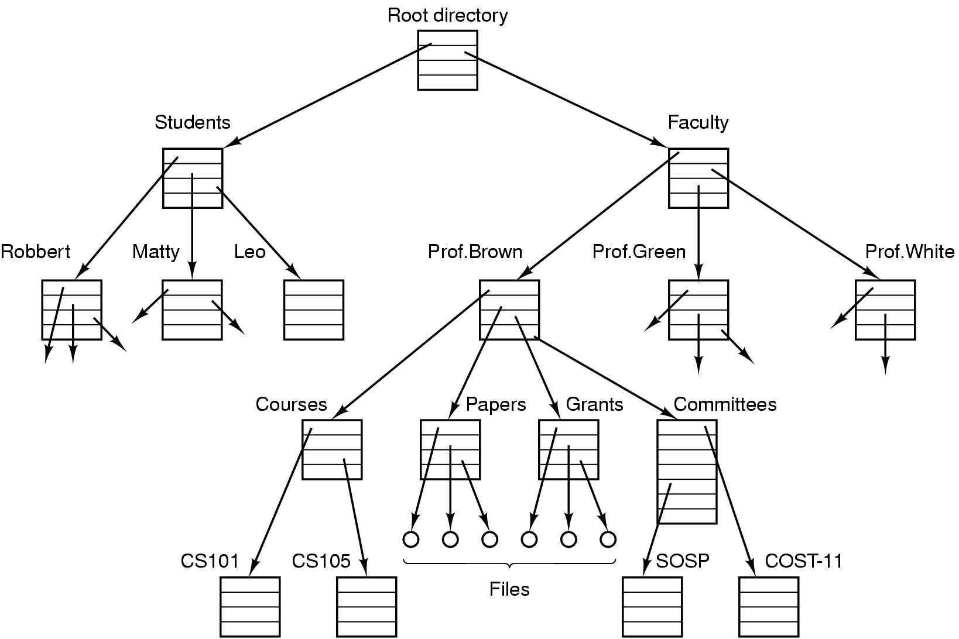
Operating System Concepts (3)
File system for a university department

Slide 46
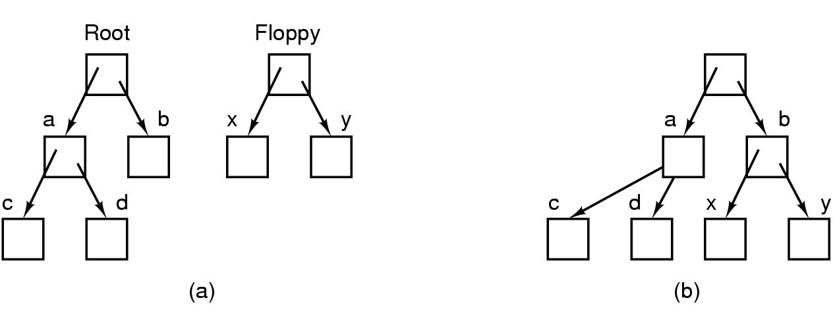
Operating System Concepts (4)
Before mounting,
files on floppy are inaccessible
After mounting floppy on b,
files on floppy are part of file hierarchy

Slide 47
Difference between Firmware and Operating System
Firmware | Operating System
Firmware is one kind of programming that is embedded on a chip in the device which controls that specific device. | OS provides functionality over and above that which is provided by the firmware.
Firmware is programs that been encoded by the manufacture of the IC or something and cannot be changed. | OS is a program that can be installed by the user and can be changed.
It is stored on non-volatile memory. | OS is stored on the hard drive.

Slide 48
Difference between 32-Bit vs. 64 Bit Operating System
Parameters | 32. Bit | 64. Bit
Architecture and Software | Allow 32 bit of data processing simultaneously | Allow 64 bit of data processing simultaneously
Compatibility | 32-bit applications require 32-bit OS and CPUs. | 64-bit applications require a 64-bit OS and CPU.
Systems Available | All versions of Windows 8, Windows 7, Windows Vista, and Windows XP, Linux, etc. | Windows XP Professional, Vista, 7, Mac OS X and Linux.
Memory Limits | 32-bit systems are limited to 3.2 GB of RAM. | 64-bit systems allow a maximum 17 Billion GB of RAM.

Slide 49
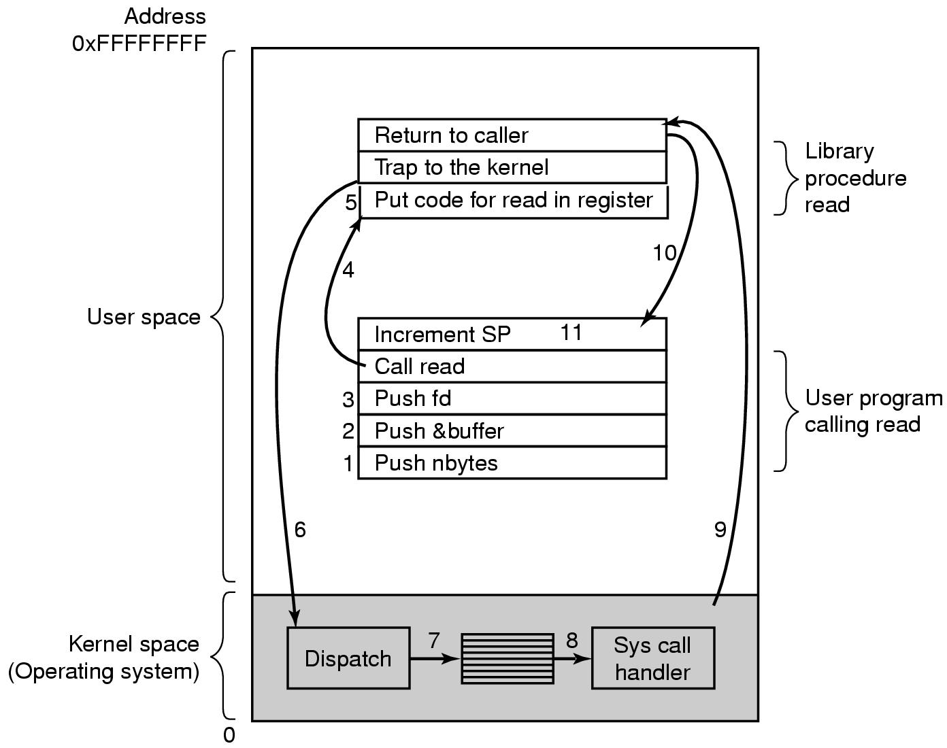
1.7 System Call
There are 11 steps in making the system call
read (fd, buffer, nbytes)

Slide 50
Types of System Calls | Windows | Linux
Process Control | CreateProcess() ExitProcess() WaitForSingleObject() | fork() exit() wait()
File Management | CreateFile() ReadFile() WriteFile() CloseHandle() | open() read() write() close()
Device Management | SetConsoleMode() ReadConsole() WriteConsole() | ioctl() read() write()
Information Maintenance | GetCurrentProcessID() SetTimer() Sleep() | getpid() alarm() sleep()
Communication | CreatePipe() CreateFileMapping() MapViewOfFile() | pipe() shmget() mmap()

Slide 51
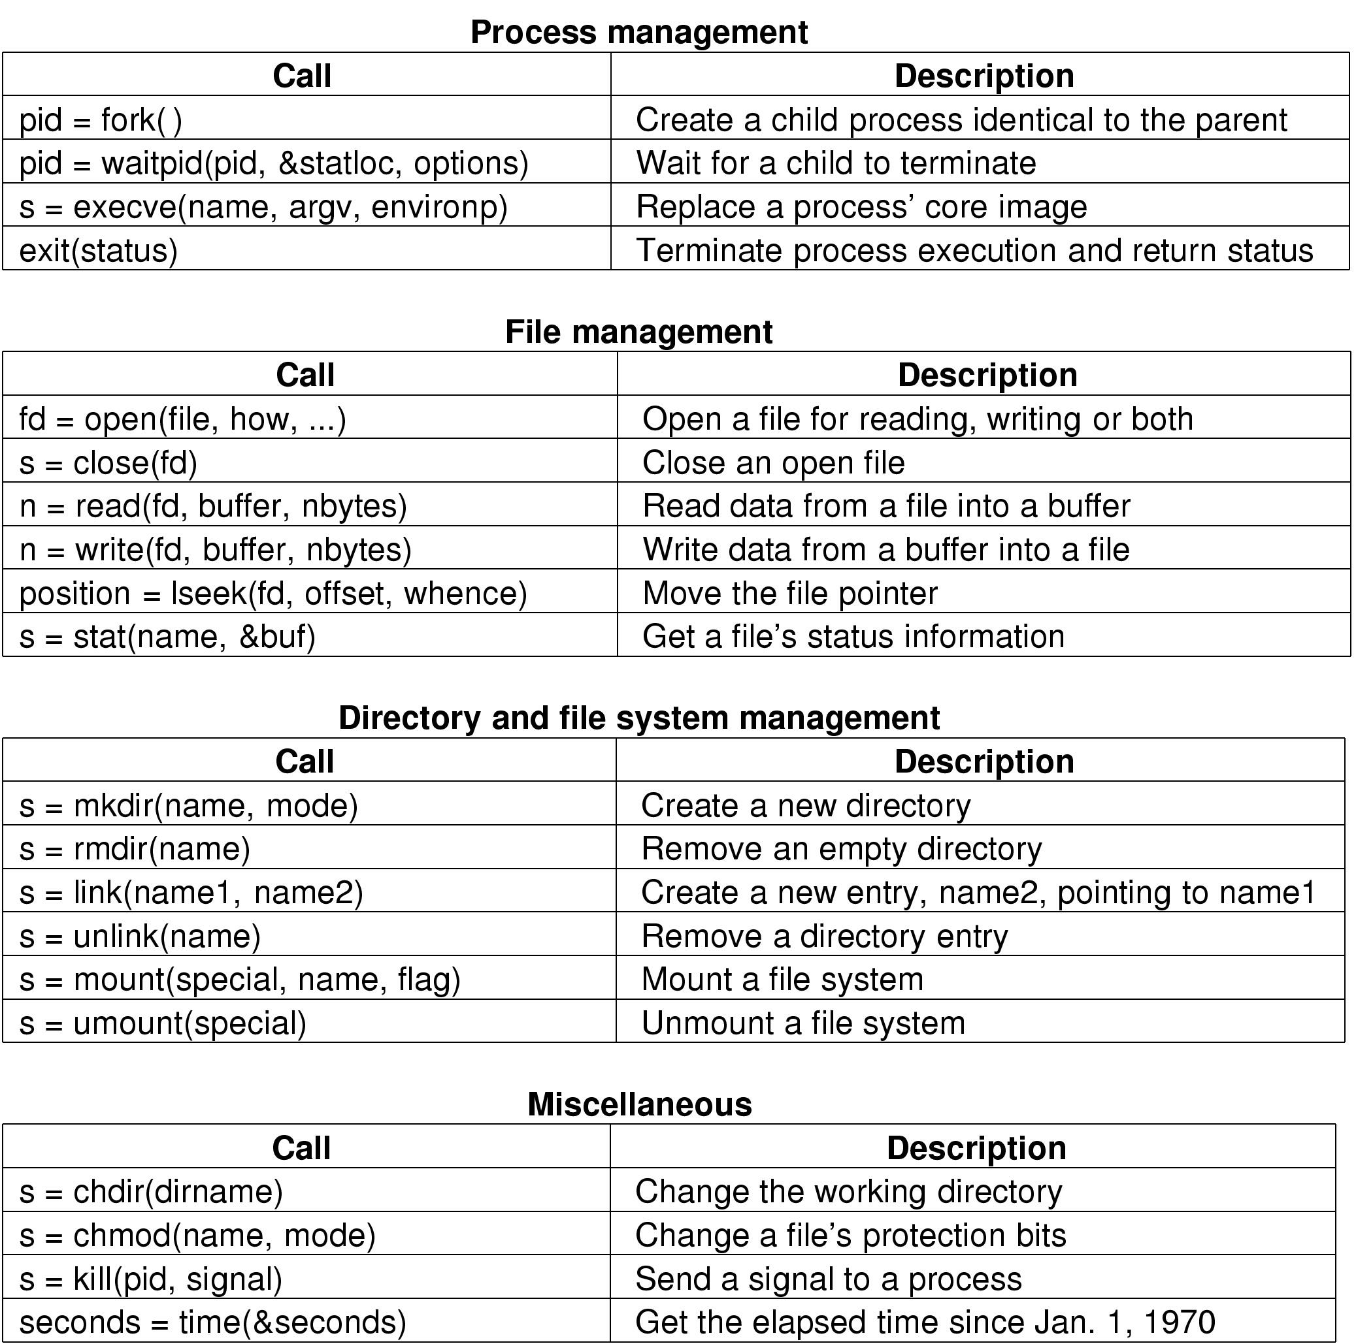
Some System Calls For Process Management

Slide 52
Some System Calls For File Management

Slide 53
Some System Calls For Directory Management

Slide 54
Some System Calls For Miscellaneous Tasks

Slide 55
System Calls (1)
A stripped down shell:
while (TRUE) { /* repeat forever */
type_prompt( ); /* display prompt */
read_command (command, parameters) /* input from terminal */
if (fork() != 0) { /* fork off child process */
/* Parent code */
waitpid( -1, &status, 0); /* wait for child to exit */
} else {
/* Child code */
execve (command, parameters, 0); /* execute command */
}}

Slide 56
1.8 Operating System Structure- Layered structure
Layered Structure is a type of system structure in which the different services of the operating system are split into various layers, where each layer has a specific well-defined task to perform. It was created to improve the pre-existing structures like the Monolithic structure ( UNIX ) and the Simple structure ( MS-DOS ).

Slide 57
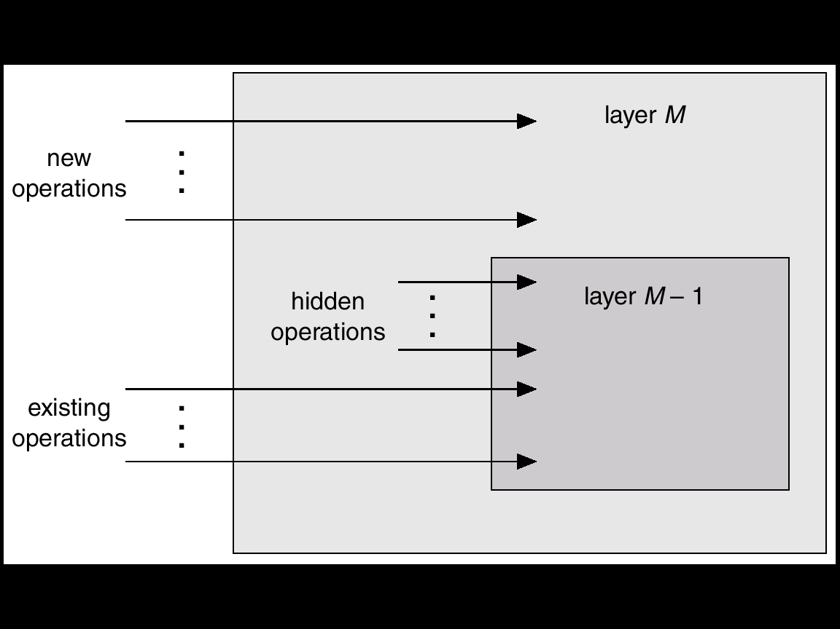
An Operating System Layer

Slide 58
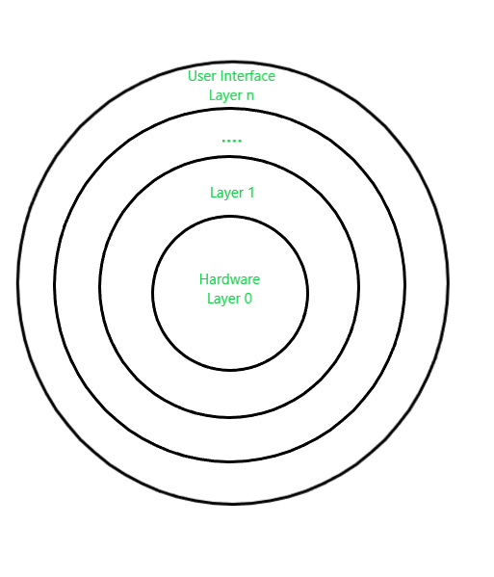
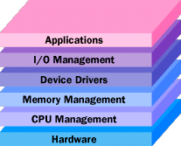
Example – The Windows NT operating system uses this layered approach as a part of it.
Design Analysis : The whole Operating System is separated into several layers ( from 0 to n ) as the diagram shows. Each of the layers must have its own specific function to perform. There are some rules in the implementation of the layers as follows.
The outermost layer must be the User Interface layer.
The innermost layer must be the Hardware layer.
A particular layer can access all the layers present below it but it cannot access the layers present above it. That is layer n-1 can access all the layers from n-2 to 0 but it cannot access the nth layer

Slide 59
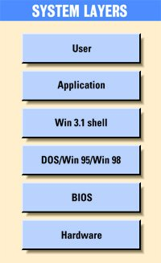
Older Windows System Layers

Slide 60
Advantages :
Modularity : This design promotes modularity as each layer performs only the tasks it is scheduled to perform.
Easy debugging : As the layers are discrete so it is very easy to debug. Suppose an error occurs in the CPU scheduling layer, so the developer can only search that particular layer to debug, unlike the Monolithic system in which all the services are present together.
Easy update : A modification made in a particular layer will not affect the other layers.
No direct access to hardware : The hardware layer is the innermost layer present in the design. So a user can use the services of hardware but cannot directly modify or access it, unlike the Simple system in which the user had direct access to the hardware.
Abstraction : Every layer is concerned with its own functions. So the functions and implementations of the other layers are abstract to it.

Slide 61
Disadvantages :
Complex and careful implementation : As a layer can access the services of the layers below it, so the arrangement of the layers must be done carefully. For example, the backing storage layer uses the services of the memory management layer. So it must be kept below the memory management layer. Thus with great modularity comes complex implementation.
Slower in execution : If a layer wants to interact with another layer, it sends a request that has to travel through all the layers present in between the two interacting layers. Thus it increases response time, unlike the Monolithic system which is faster than this. Thus an increase in the number of layers may lead to a very inefficient design.

Slide 62
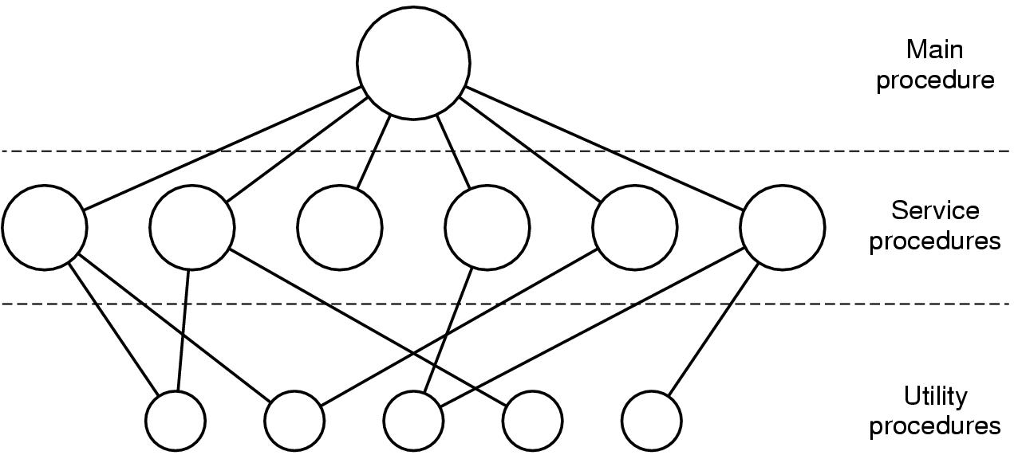
1.8 Operating System Structure (1)
Simple structuring model for a monolithic system

Slide 63
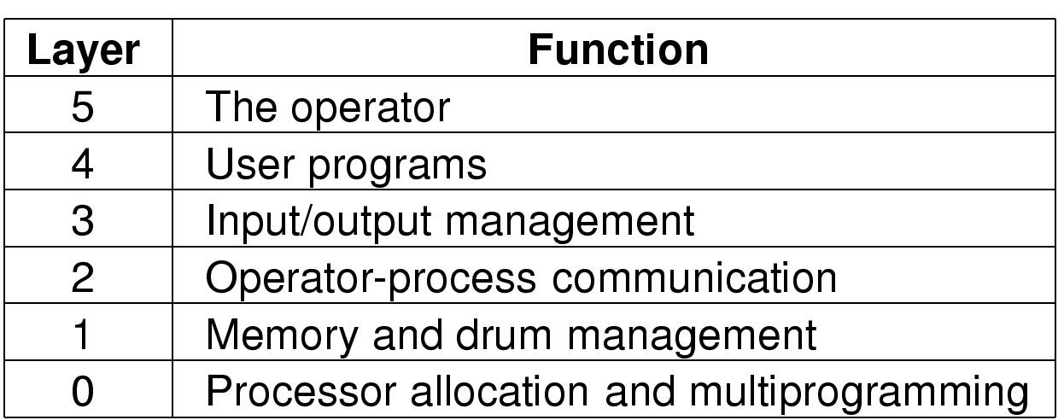
Operating System Structure (2)
Structure of the operating system

Slide 64
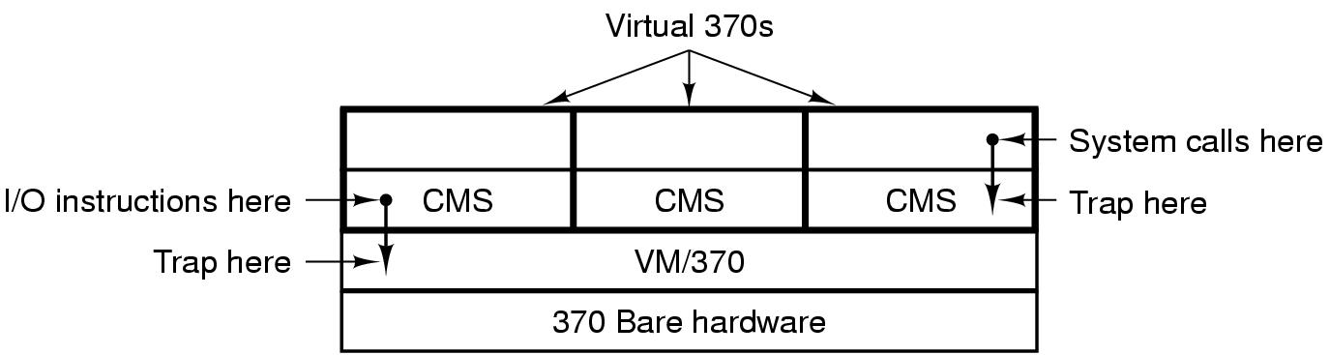
Operating System Structure (3)
Structure of VM/370 with CMS

Slide 65
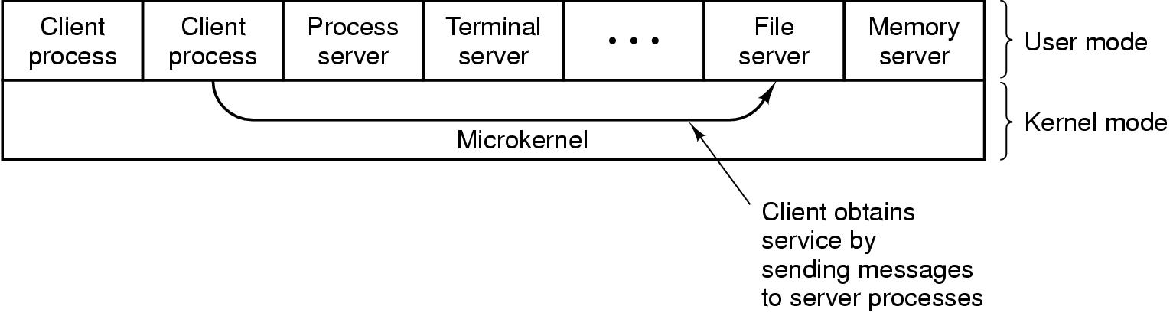
Operating System Structure (4)
The client-server model

Slide 66
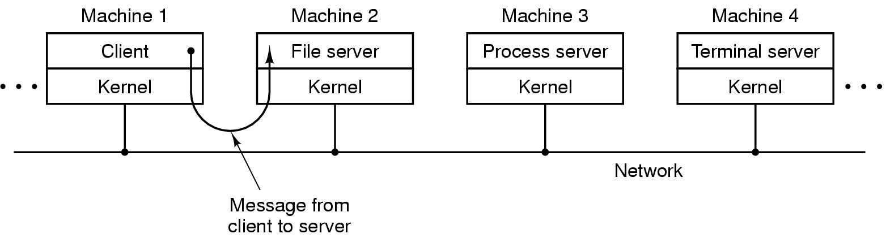
Operating System Structure (5)
The client-server model in a distributed system

Slide 67

Operating Systems Structures
Structure/Organization/Layout of OSs:
Monolithic (one unstructured program)
Layered
Microkernel
Virtual Machines
The role of Virtualization

Slide 68
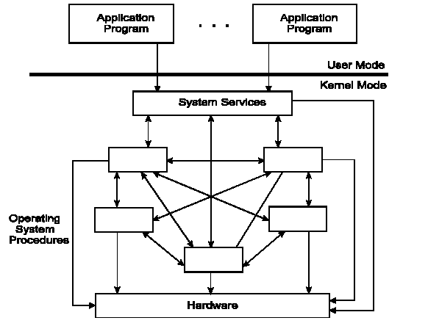
Monolithic Operating System

Slide 69
Monolithic OS – basic structure
Application programs that invokes the requested system services.
A set of system services that carry out the operating system procedures/calls.
A set of utility procedures that help the system services.

Slide 70
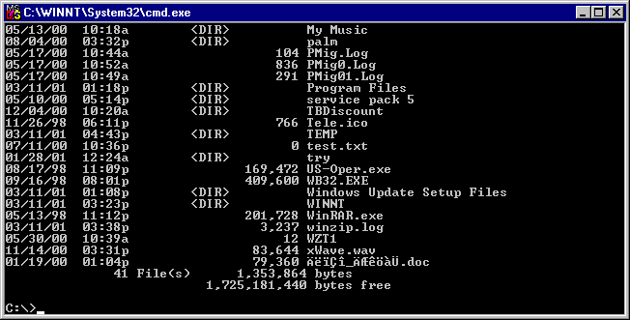
MS-DOS System Structure
MS-DOS – written to provide the most functionality in the least space:
not divided into modules (monolithic).
Although MS-DOS has some structure, its interfaces and levels of functionality are not well separated.

Slide 71
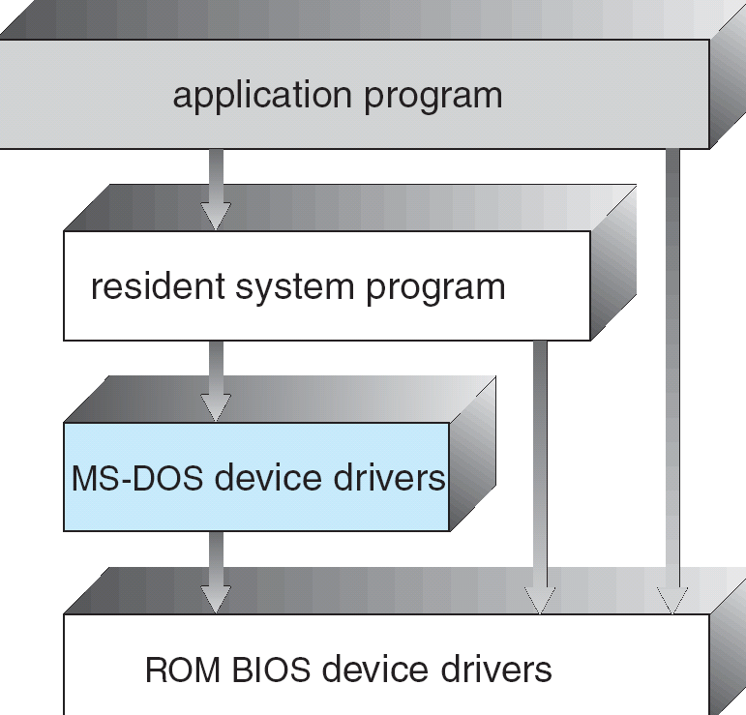
MS-DOS Layer Structure
Notes:
71

Slide 72

UNIX System Structure
UNIX – limited by hardware functionality, the original UNIX OS had limited structuring.
The UNIX OS consists of two separable parts:
Systems Programs:
The Kernel:
Consists of everything below the system-call interface and above the physical hardware.
Provides the file system, CPU scheduling, memory management, and other operating-system functions; a large number of functions for one level.

Slide 73
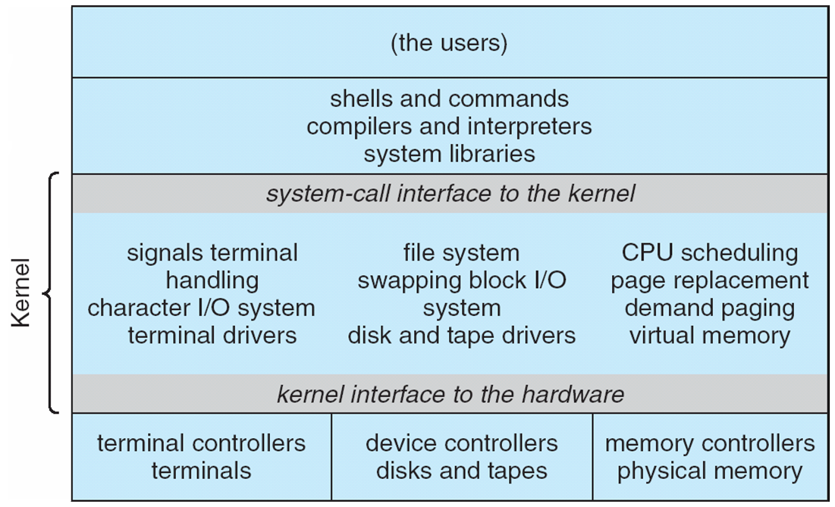
Traditional UNIX System Structure
Notes:
73

Slide 74
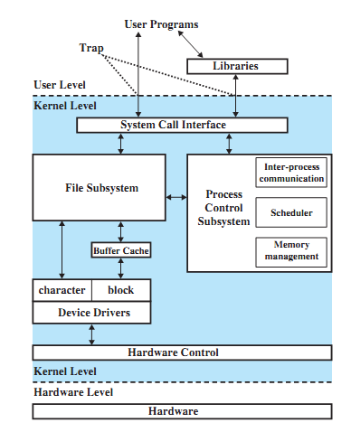
Traditional UNIX Kernel

Slide 75
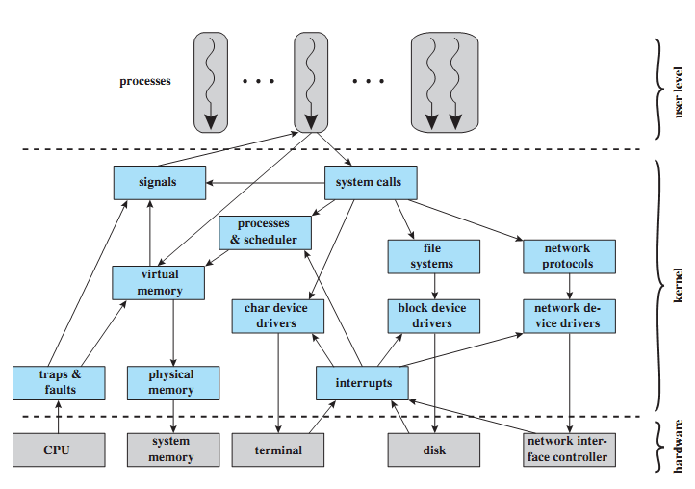
LINUX Kernel Components

Slide 76
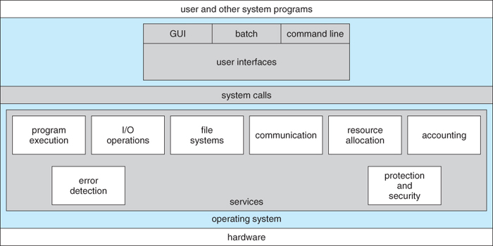
2.0 Operating-System Services

Slide 77
User Interfaces - Means by which users can issue commands to the system. Depending on the system these may be a command-line interface ( e.g. sh, csh, ksh, tcsh, etc. ), a GUI interface ( e.g. Windows, X-Windows, KDE, Gnome, etc. ), or a batch command systems. The latter are generally older systems using punch cards of job-control language, JCL, but may still be used today for specialty systems designed for a single purpose.
Program Execution - The OS must be able to load a program into RAM, run the program, and terminate the program, either normally or abnormally.
I/O Operations - The OS is responsible for transferring data to and from I/O devices, including keyboards, terminals, printers, and storage devices.
File-System Manipulation - In addition to raw data storage, the OS is also responsible for maintaining directory and subdirectory structures, mapping file names to specific blocks of data storage, and providing tools for navigating and utilizing the file system.
Communications - Inter-process communications, IPC, either between processes running on the same processor, or between processes running on separate processors or separate machines. May be implemented as either shared memory or message passing, ( or some systems may offer both. )

Slide 78
Error Detection - Both hardware and software errors must be detected and handled appropriately, with a minimum of harmful repercussions. Some systems may include complex error avoidance or recovery systems, including backups, RAID drives, and other redundant systems. Debugging and diagnostic tools aid users and administrators in tracing down the cause of problems.
Other systems aid in the efficient operation of the OS itself:
Resource Allocation - E.g. CPU cycles, main memory, storage space, and peripheral devices. Some resources are managed with generic systems and others with very carefully designed and specially tuned systems, customized for a particular resource and operating environment.
Accounting - Keeping track of system activity and resource usage, either for billing purposes or for statistical record keeping that can be used to optimize future performance.
Protection and Security - Preventing harm to the system and to resources, either through wayward internal processes or malicious outsiders. Authentication, ownership, and restricted access are obvious parts of this system. Highly secure systems may log all process activity down to excruciating detail, and security regulation dictate the storage of those records on permanent non-erasable medium for extended times in secure ( off-site ) facilities

Slide 79
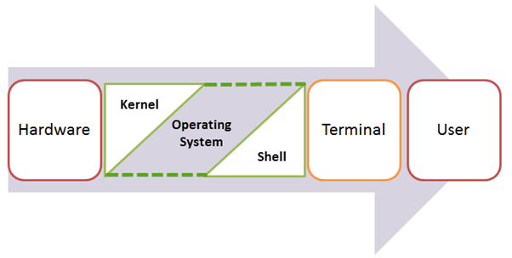
2.1What is a Kernel
The kernel is the central component of a computer operating systems. The only job performed by the kernel is to the manage the communication between the software and the hardware.
A Kernel is at the nucleus of a computer. It makes the communication between the hardware and software possible. While the Kernel is the innermost part of an operating system, a shell is the outermost one.

Slide 80
Features of Kennel
Low-level scheduling of processes
Inter-process communication
Process synchronization
Context switching

Slide 81
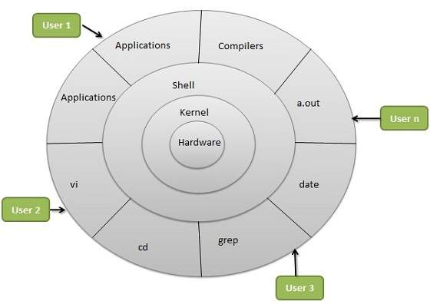

Slide 82
Types of Kernels
Monolithic
A monolithic kernel is a single code or block of the program. It provides all the required services offered by the operating system. It is a simplistic design which creates a distinct communication layer between the hardware and software.
Microkernels
Microkernel manages all system resources. In this type of kernel, services are implemented in different address space. The user services are stored in user address space, and kernel services are stored under kernel address space. So, it helps to reduce the size of both the kernel and operating system.

Slide 83
Differences between kernel and OS are
Kernel | Operating System
Kernel is the core part of operating system | Operating system (OS) is a collection of software that manages computer hardware resources
It acts as an interface between software and hardware of the computer system. | It acts as an interface between user and hardware of the computer
It plays an important role in memory management, task management, process management and disk management. | It responsible for protection and security of the computer system.
Monolithic Kernel and Micro kernel are the two types of kernel. | Single and Multiprogramming batch system, Distributed operating system, Real-time operating system are the types of operating system.

Slide 84
There are two modes of operation in the operating system to make sure it works correctly. These are user mode and kernel mode.
User Mode
The system is in user mode when the operating system is running a user application such as handling a text editor. The transition from user mode to kernel mode occurs when the application requests the help of operating system or an interrupt or a system call occurs.
The mode bit is set to 1 in the user mode. It is changed from 1 to 0 when switching from user mode to kernel mode.
Kernel Mode
The system starts in kernel mode when it boots and after the operating system is loaded, it executes applications in user mode. There are some privileged instructions that can only be executed in kernel mode.
These are interrupt instructions, input output management etc. If the privileged instructions are executed in user mode, it is illegal and a trap is generated.
The mode bit is set to 0 in the kernel mode. It is changed from 0 to 1 when switching from kernel mode to user mode.

Slide 85
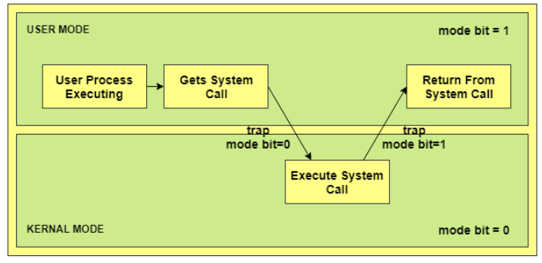
In the above image, the user process executes in the user mode until it gets a system call. Then a system trap is generated and the mode bit is set to zero. The system call gets executed in kernel mode. After the execution is completed, again a system trap is generated and the mode bit is set to 1. The system control returns to kernel mode and the process execution continues.

Slide 86
Necessity of Dual Mode (User Mode and Kernel Mode) in Operating System
The lack of a dual mode i.e user mode and kernel mode in an operating system can cause serious problems. Some of these are −
A running user program can accidentaly wipe out the operating system by overwriting it with user data.
Multiple processes can write in the same system at the same time, with disastrous results.
These problems could have occurred in the MS-DOS operating system which had no mode bit and so no dual mode.

Slide 87
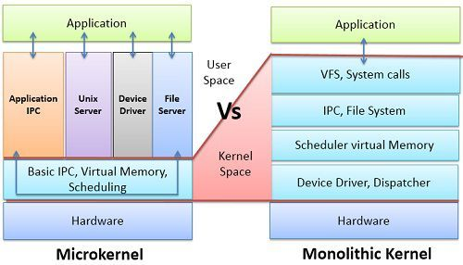
Difference Between Microkernel and Monolithic Kernel

Slide 88
BASIS FOR COMPARISON | MICROKERNEL | MONOLITHIC KERNEL
Basic | In microkernel user services and kernel, services are kept in separate address space. | In monolithic kernel, both user services and kernel services are kept in the same address space.
Size | Microkernel are smaller in size. | Monolithic kernel is larger than microkernel.
Execution | Slow execution. | Fast execution.
Extendible | The microkernel is easily extendible. | The monolithic kernel is hard to extend.
Security | If a service crashes, it does effect on working of microkernel. | If a service crashes, the whole system crashes in monolithic kernel.
Code | To write a microkernel, more code is required. | To write a monolithic kernel, less code is required.
Example | QNX, Symbian, L4Linux, Singularity, K42, Mac OS X, Integrity, PikeOS, HURD, Minix, and Coyotos. | Linux, BSDs (FreeBSD, OpenBSD, NetBSD), Microsoft Windows (95,98,Me), Solaris, OS-9, AIX, HP-UX, DOS, OpenVMS, XTS-400 etc.

Slide 89
Advantages of Monolithic Kernel –
One of the major advantage of having monolithic kernel is that it provides CPU scheduling, memory management, file management and other operating system functions through system calls.
The other one is that it is a single large process running entirely in a single address space.
It is a single static binary file. Example of some Monolithic Kernel based OSs are: Unix, Linux, Open VMS, XTS-400, z/TPF.
Disadvantages of Monolithic Kernel –
One of the major disadvantage of monolithic kernel is that, if anyone service fails it leads to entire system failure.
If user has to add any new service. User needs to modify entire operating system

Slide 90
Advantages of Microkernel
Microkernel architecture is small and isolated therefore it can function better.
Microkernels are secure because only those components are included that disrupt the functionality of the system otherwise.
The expansion of the system is more accessible, so it can be added to the system application without disturbing the Kernel.
Microkernels are modular, and the different modules can be replaced, reloaded, modified without even touching the Kernel.
Fewer system crashes when compared with monolithic systems.
Without recompiling, add new features
Server malfunction is also isolated as any other user program's malfunction.
Microkernel system is flexible, so different strategies and APIs, implemented by different servers, which can coexist in the system.
Increased security and stability will result in a decreased amount of code which runs on kernel mode

Slide 91
Disadvantage of Microkernel
Providing services in a microkernel system are expensive compared to the normal monolithic system.
Context switch or a function call needed when the drivers are implemented as procedures or processes, respectively.
The performance of a microkernel system can be indifferent and may lead to some problem

Slide 92

Thank You!!

